Slide 1

Technical Advisory Committee
November 5, 2025

Slide 2
Meeting Agenda
2025-26 workplan update.
2026-27: A preliminary discussion.
Other business.
Adjournment.

Slide 3
2025-26 Work Plan
V5.0: Started biweekly brainstorming meetings.
V4.3 updates: next slide.
GGH 2022 network: NCS revisions.

Slide 4
V4.3 Updates
Incremental auto passenger updates being implemented.
PTC supply implementation continuing.
Bicycle route choice continuing: starting to estimate models.
Transit reliability modelling (next slides).

Slide 5
Network Coding Standard Revisons
Henry Waterhouse
TMG Network Modeller

Slide 6
Node Renumbering
NCS will need to be updated
TTS 2022 zones go up to 30,000 which eats into current regular node numbering range

Slide 7
Potential Solutions
Potential approach for TTS 2022 compatibility is moving regular node ranges up by 100,000 and giving each region 10,000 node range
Do people want larger ranges per region?
For example, future proofing for an all-streets network
Other potential uses?
Open to suggestions on how to modify the regular node ranges

Slide 8
Any other suggestions for NCS updating?
Would also like to check modes against MTO to see if we're still aligned for v5

Slide 9
Modelling Transit Reliability in Emme
Mohammad Ansari Esfeh
NSERC Postdoctoral Fellow

Slide 10
2026-27 Preliminary Discussion

Slide 11
Possible Tasks (1): GTAModel Updates
V4.3: Calibration may continue into spring of 2026?
V5.0:
How much TMG staff time to allocate to this relative to other tasks?
Availability of grad students & postdocs to work on this?

Slide 12
Possible Tasks (2): Continuing Work
Transit reliability.
Improved VDFs.
Carpooling.
Bicycle route/mode choice.
…
Probit covariances.
Generalizing the model to enhance transferability to other locations.
XTMF2 development.
Parameters are buried in software hierarchies – hinders transferability
Applying lessons learned; refactoring.

Slide 13
Possible Tasks (3): Improved Post-Processing (1): Metrics/KPIs
User benefits.
Operating & user costs.
Environmental impacts.
Accessibilities.
By mode, purpose/activity, socio-economic group (low income, etc.).
TTC benefits study provides a starting point for developing user-controlled automated outputs.
Bryce (CoT) has been working on a set of tools in Python. Based on some earlier work by WSP. Time to bring this into the TMG Git Hub. Present at a future TMGTAC meeting.
Input preparation methods. Yes!
Integrated: metadata/documentation with methods.
Testing.

Slide 14
Possible Tasks (4): Improved Post-Processing (2): Scenario Comparisons
Automated procedures for comparing outputs from two (or more?) scenarios:
O-D matrices.
Mode shares.
Network loadings.
…
Tables, graphs, maps.
Moving towards a “dashboard”?
Arguably everyone is still doing a lot of repetitive “bespoke” post-processing of results?

Slide 15
Possible Tasks (5): Opening up key models
PoRPoW.
PoRPoS.
Auto ownership (EVs).
Population synthesis.
…?

Slide 16
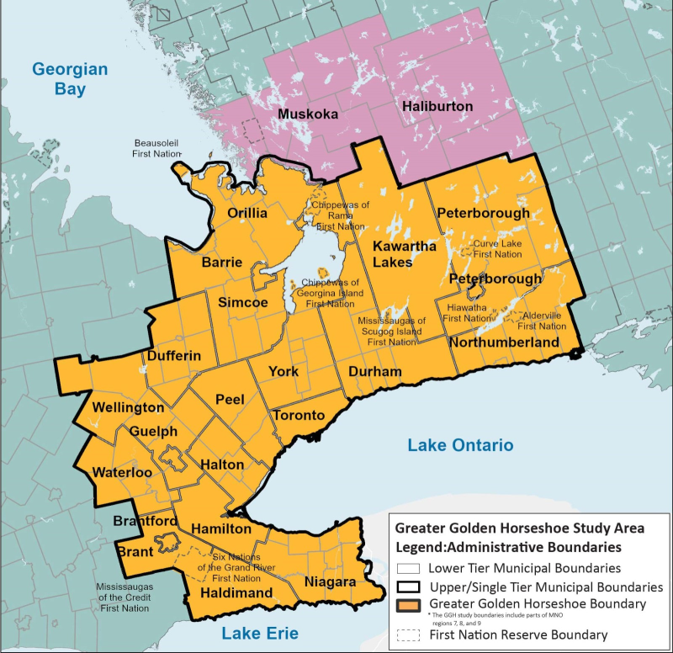
Possible Tasks (6): Spatial Structure
The GGH contains 9 CMAs – which are defined as coherent commuter sheds.
But we tend to model PoRPoW with a single model.
Maybe a hierarchical model structure makes more sense?

Slide 17

Let’s Discuss!

Slide 18

Other Business

Slide 19
2025-26 Meeting Schedule
TMG Technical Advisory Committee Meetings (10:00-12:00):
January 7, 2026
February 4, 2026
TMG Workshops (10:00-12:00):
December 3, 2025
March 25, 2026
TMG Steering Committee Meetings (10:00-12:00):
March 4, 2026
All meetings online on MS Teams.

Slide 20
We are adjourned! Thank you!
The End!

