Slide 1
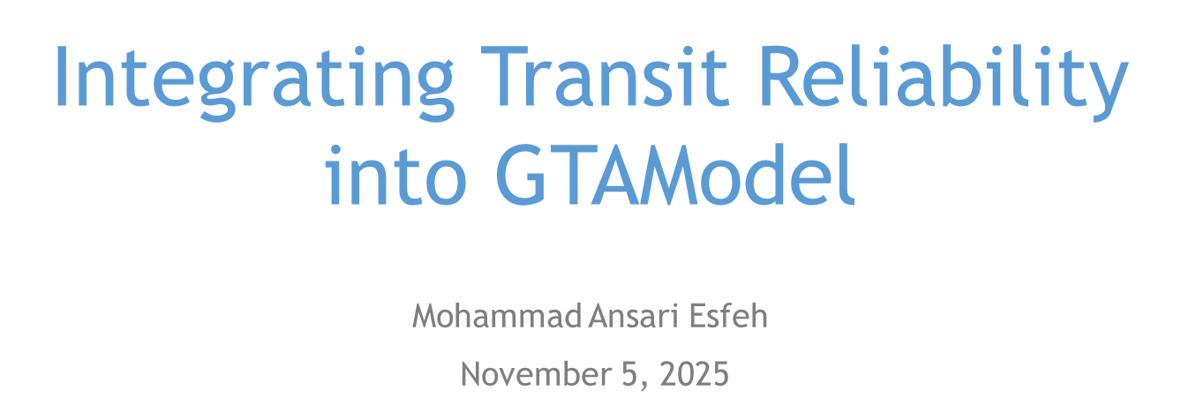

Slide 2
Introduction
Activity-based, regional travel demand model developed by TMG (UofT).
Represents daily travel choices across different time periods (AM, Midday, PM, Evening, Overnight).
Used by agencies for planning and forecasting demand and policy/infrastructure impacts.
Outputs: mode choice, path assignment, and system-level performance indicators.

Slide 3
Why Reliability Matters
GTAModel currently uses scheduled headways, assuming regular service.
Does not model delay variability, bunching, or capacity effects.
Implicitly assumes 100% bus service reliability.
Possibly results in biased ridership forecasts and travel patterns.

Slide 4
Objective & Framework
Objective: Incorporate observed reliability into GTAModel transit costs.
Calculate Expected Waiting Time (EWT) using headway variability and crowding.
Derive Effective Headway and Line Reliability Index (LRI).
Replace idealized wait times with reliability-adjusted skims.

Slide 5




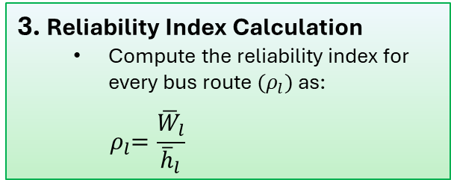



Objective & Framework
$\text{Oberved} \text{headway} \text{distribution}$: ${\tilde{f}}_{l}(h)$
Simulated waiting time $:\overline{W}$
$$Line l$$
$$Bus limited capacity$$
$$Scheduled headway{ \overline{h}}_{l}$$
$$Uniform arrival rate$$
1. Input
Bus Capacity (e.g., 60 pax/bus)
Timeframe (e.g. 6:00 AM–9:00 AM)
AVL Data: to obtain observed headway distribution during the defined timeframe.
APC Data: to obtain passenger arrival pattern during the defined timeframe.
3. Reliability Index Calculation
Compute the reliability index for every bus route ${(ρ}_{l})$ as:
$${ ρ}_{l}=\frac{{\overline{W}}_{l}}{{\overline{h}}_{l}}$$
4. Integration into the GTAModel
Transfer the simulation code and the AVL and APC data into the GTAModel.
2. Simulation Execution
Compute the average passenger waiting time during the timframe.

Slide 6
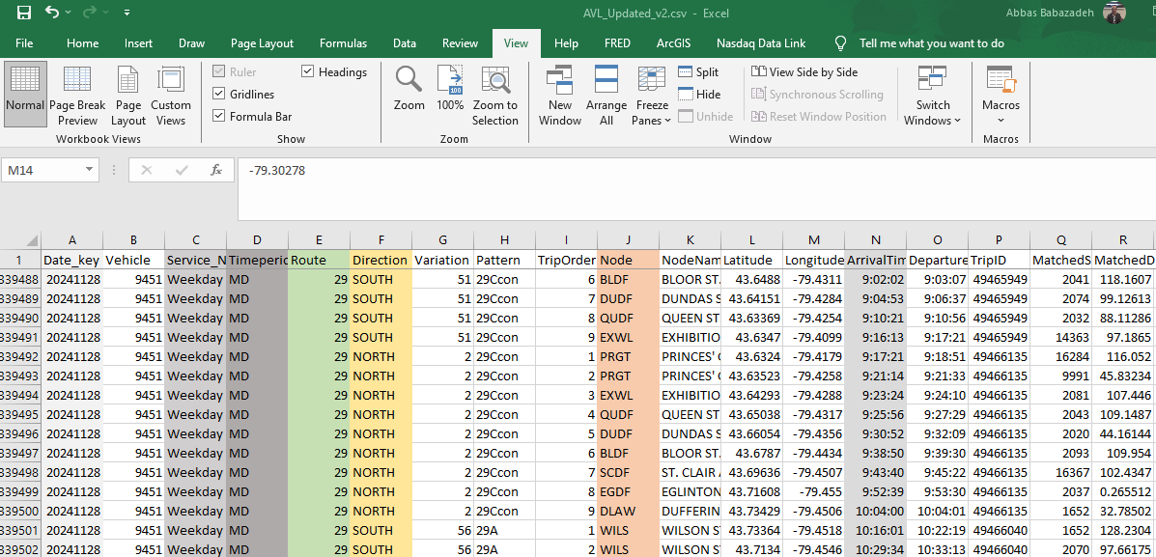
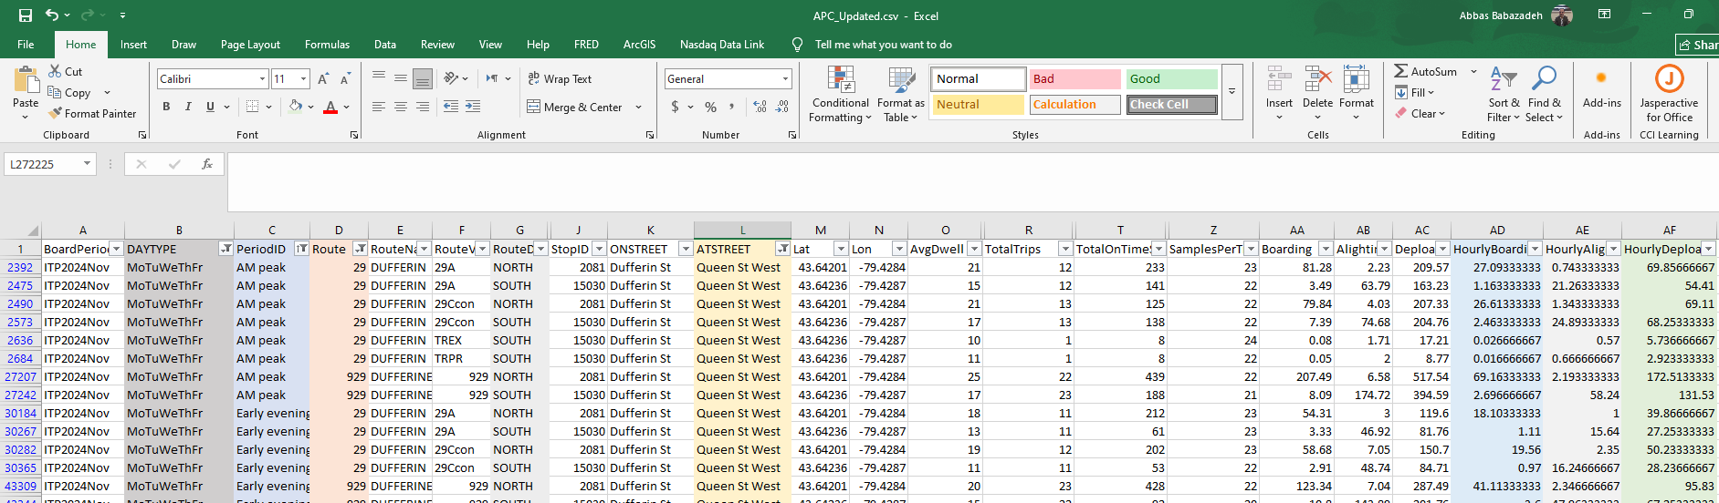
Data Processing
AVL Data
APC Data

Slide 7
Results
Line 29 North
Time period | Average Headway (min) | Average Waiting Time (min) | Effective Headway (min) | Reliability Index
AM | 4.63 | 3.38 | 4.77 | 0.73
PM | 4.54 | 3.81 | 4.84 | 0.84

Slide 8
What Has Been Done
AVL and APC data processing
Bus service reliability modeling
Simulation coding and analysis
Reliability index calculation

Slide 9
Next Steps
Short term:
Integrate the code and data into the GTAModel.
Medium term:
Model bus load factor and crowding.
Integrate load factor and crowing into the GTAModel.

Slide 10

Thank you!

