Slide 1
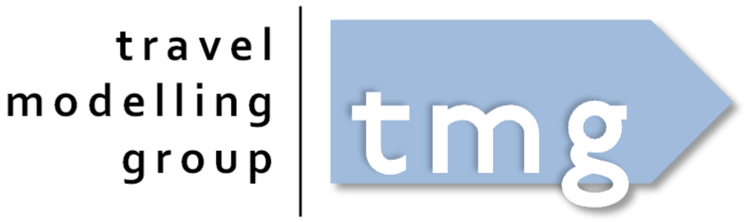
GTAModel Calibration Process
TMG March Workshop (2026.03.25)

Slide 2
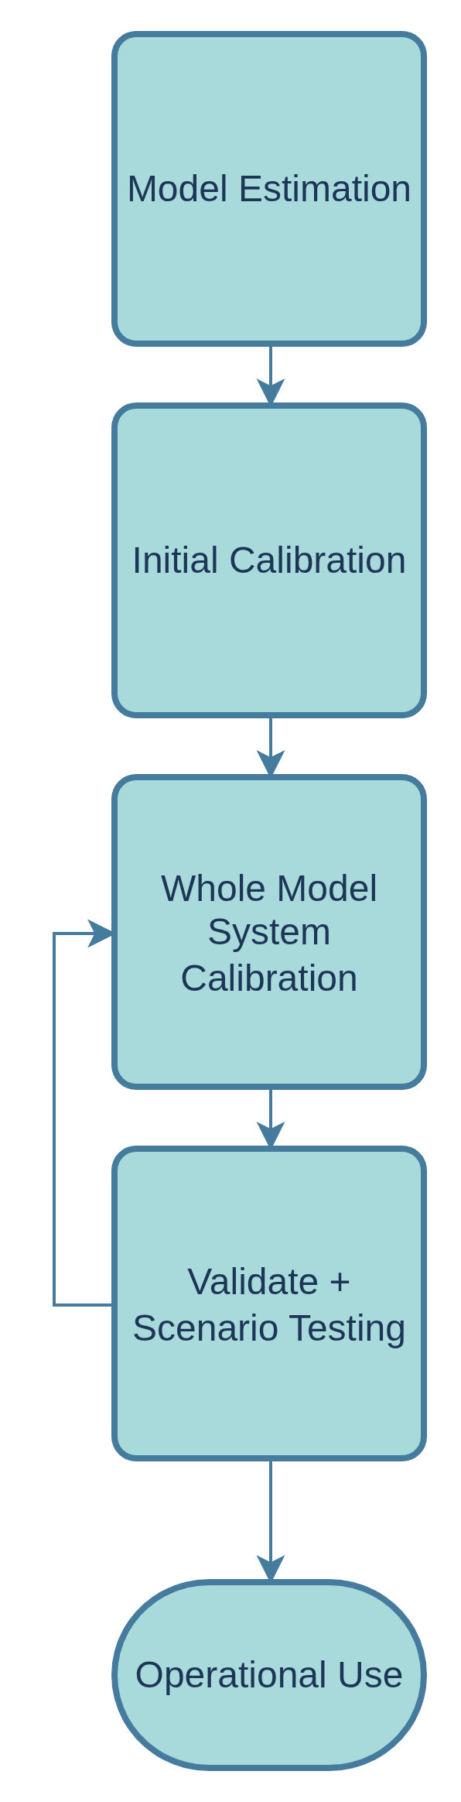
Workflow
Estimation maximizes a global likelihood, but errors towards the average for individual models
Calibration then takes a set of behaviorally coherent model and lets us hit observed targets.
Calibration is broken down into two phases, an initial calibration without iteration and then whole model system calibration
Calibration allows us to focus on multiple objectives while models interact with each other
Calibration tends to be done at the super zone (Planning District) level or groups of super zones.

Slide 3
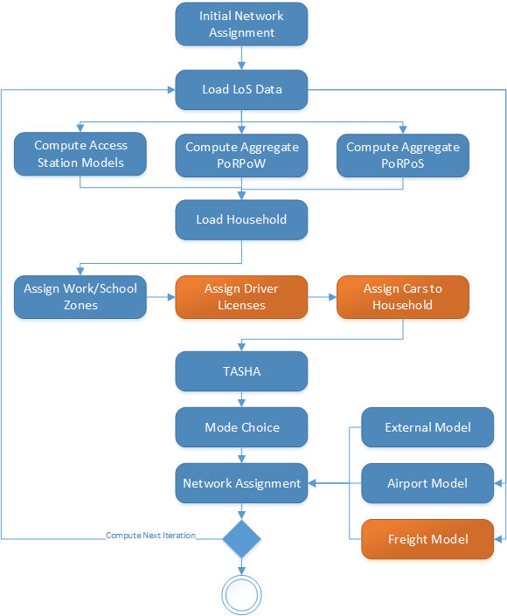
GTAModel V4.2 Structure

Slide 4
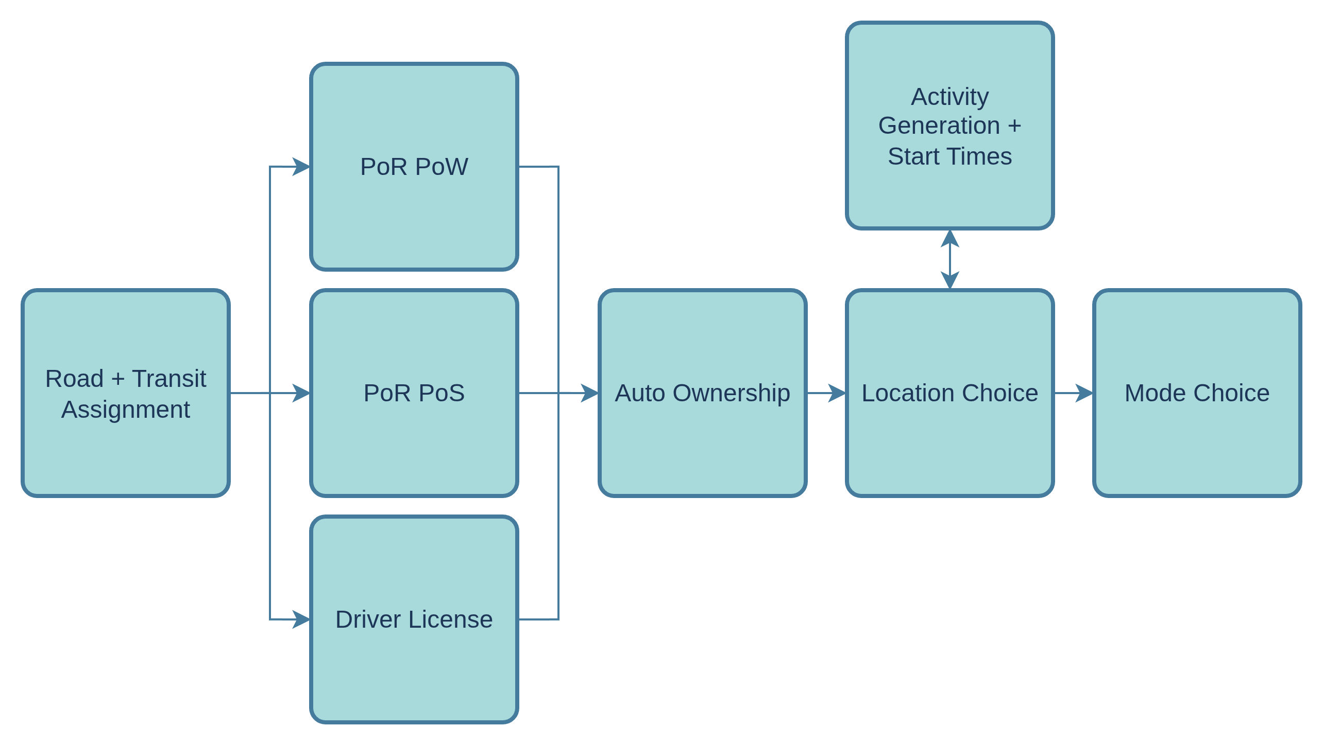
Calibration Dependencies
Notes:
Walk through our different dependencies
* Road + Transit Assignment calibration is only calibrated in the first pass
* Everything else is calibrated by their dependency using LoS with fixed base year demand
* We then analyze the

Slide 5
So How Do We Actually Do it?
Each model has a variety of different constants, or k-factors, that allow us to nudge the model.
Run the model
Identify where the model is most out of calibration
Add factors and or slightly adjust the parameters
Iterate

Slide 6
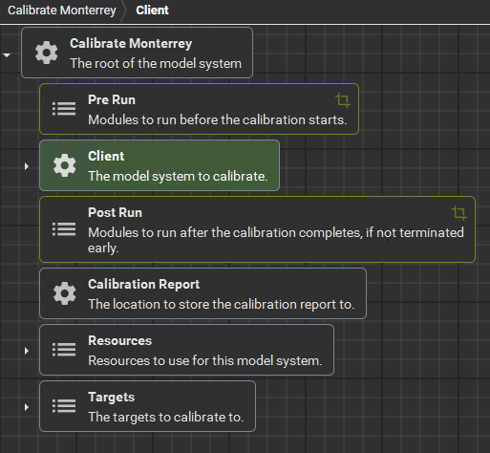
Automated Calibration Framework
Available in XTMF 1.15 (out today)
Allows you to specify Targets that get tied back to specific parameters

Slide 7
Target Types
Probability
  If you can express what the goal is in a value between 0 and 1
  Mode Shares, Location Choices as a split for different spatial segments
Non-Probability
  If you can only express what you need as a total number
  e.g. There are X market trips over the day generated from people living in Downtown Toronto
Notes:
* Probability Targets are preferred as they do not require additional model runs
* Non-Probability targets require an additional run each in order to approximate the derivative

Slide 8
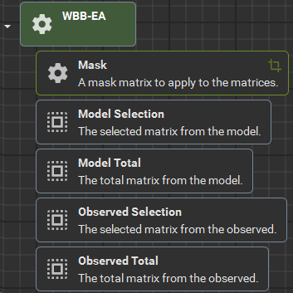
Probability Matrix Target - Submodules
Mask
Model Selection
Model Total
Observed Selection
Observed Total
Notes:
Mask - A matrix with the values of 0 or 1. If the value is 0, the cell will be ignored.
Model Selection - A matrix containing the number of generated observations that were selected for each cell.
Model Total - A matrix containing the total number of generated observations for each cell.
Observed Selection - A matrix containing the number of observations that were selected for each cell.
Observed Total - A matrix containing the total number of observations for each cell.

Slide 9
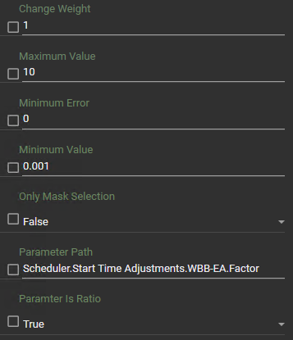
Probability Matrix Target - Parameters
Change Weight
Maximum Value
Minimum Error
Minimum Value
Only Mask Selection
Parameter Path
Parameter Is Ratio
Notes:
Parameter Is Ratio – Set this to true when working with

Slide 10
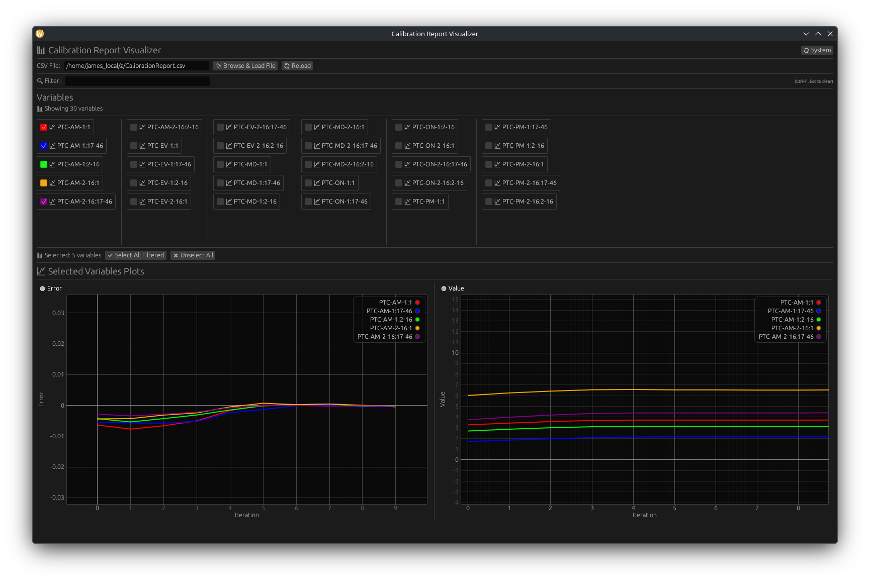
Calibration Output
CSV File with errors and the Values used per iteration
Calibration Report
Visualizer available
  https://github.com/JamesVaughan/visualize_calibration_report

Slide 11
Documentation
TMG Documentation
  https://tmg.utoronto.ca/doc
GTAModel V4 Calibration Guide
  https://tmg.utoronto.ca/doc/1.6/gtamodel/calibration/index.html
For more about the automated calibration framework
  https://tmg.utoronto.ca/doc/1.6/xtmf/frameworks/automated_calibration.html

Slide 12
Live Walkthrough

