Slide 1

Technical Advisory Committee Meeting
June 3, 2026

Slide 2

Agenda
Workplan Updates:
  GGH Network.
  Toolbox 2.
XTMF2 Update.
Review of pop/emp forecasting.
Other Business.
Meeting Schedule.
Adjournment.

Slide 3
2026-27 Work Plan

Slide 4
GGH Network Update
Have assigned 2022 TTS to network
  Started validation
To Do
  Fine tune centroid connectors
  Potentially adjust some GGH regions
  Continue validation

Slide 5
Parking Data
Mostly collected, from open data sites
If you have data to share, please reach out
Region | Data Collected | Niagara | Y
Toronto | Y | Welland | Y
Durham | N | Kitchener-Waterloo | Y
York | N | Cambridge | Y
Brampton | Y | Guelph | Y
Mississauga | Y | Orangeville | Y
Milton | N | Barrie | Y
Oakville | Y | Orillia | N
Burlington | Y | Kawartha Lakes | N
Hamilton | Y | Peterborough | Y

Slide 6
Toolbox 2 Update
Continuing our conversion of the Toolbox1 tools to Python3
Testing tools to ensure they work with latest version of EMME
Continuing optimizing and refactoring tools
Updating Toolbox2 documentation

Slide 7
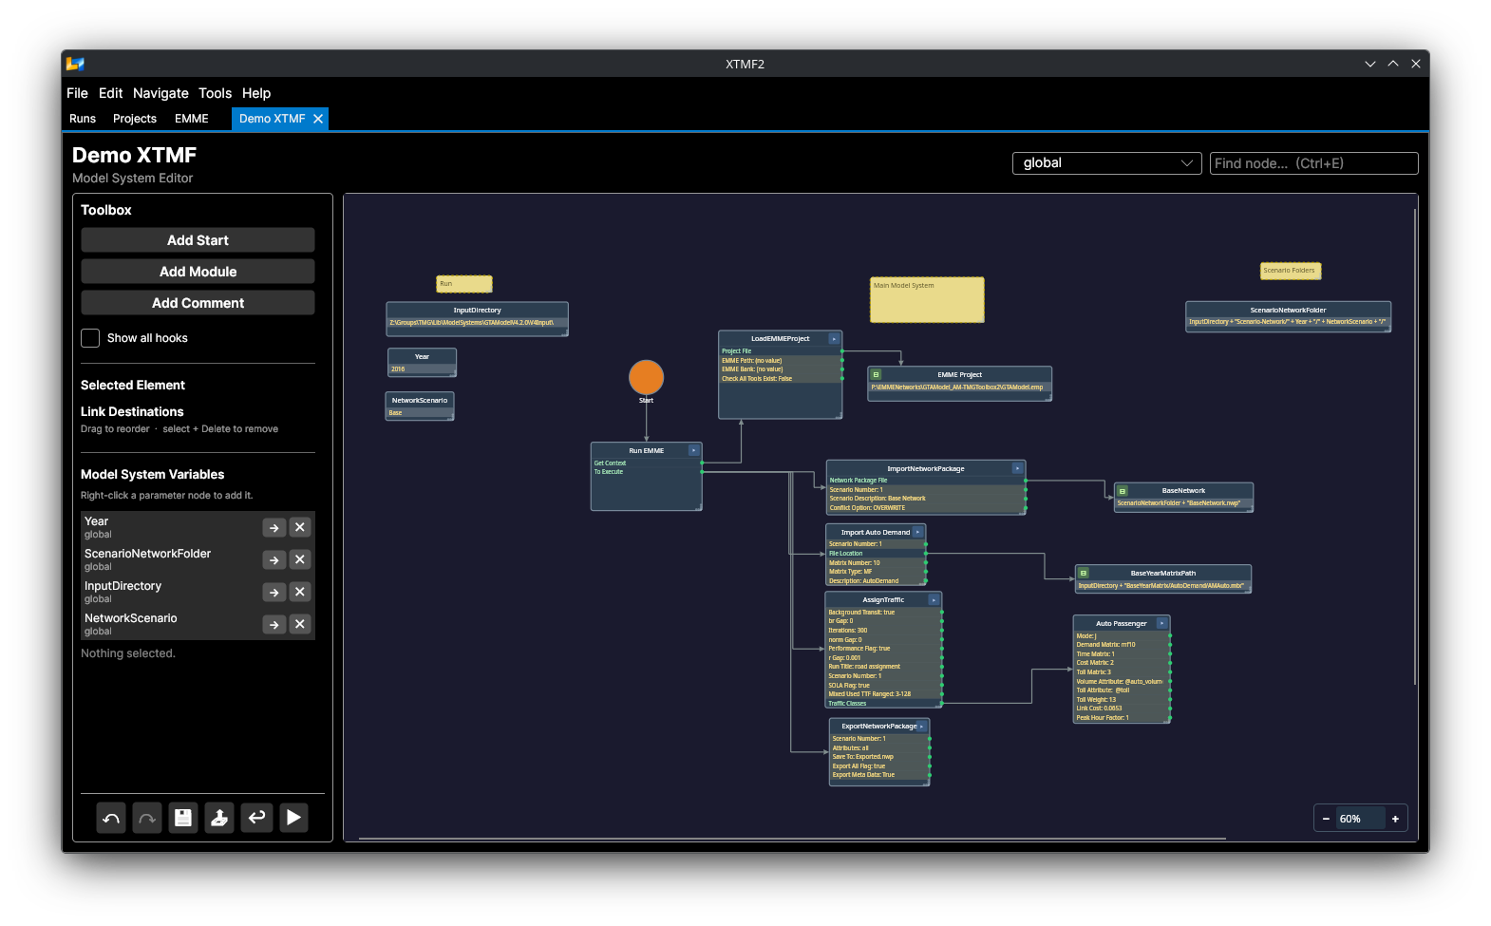
XTMF 2

Slide 8
XTMF2 - Progress
XTMF2 development continues
The following slides goes over latest graphical implementation
File formats and GUI elements will likely change before XTMF V2.0 is released
Notes:
Make sure that everyone knows that XTMF2 is not ready for use. File formats will change and likely break model systems.

Slide 9
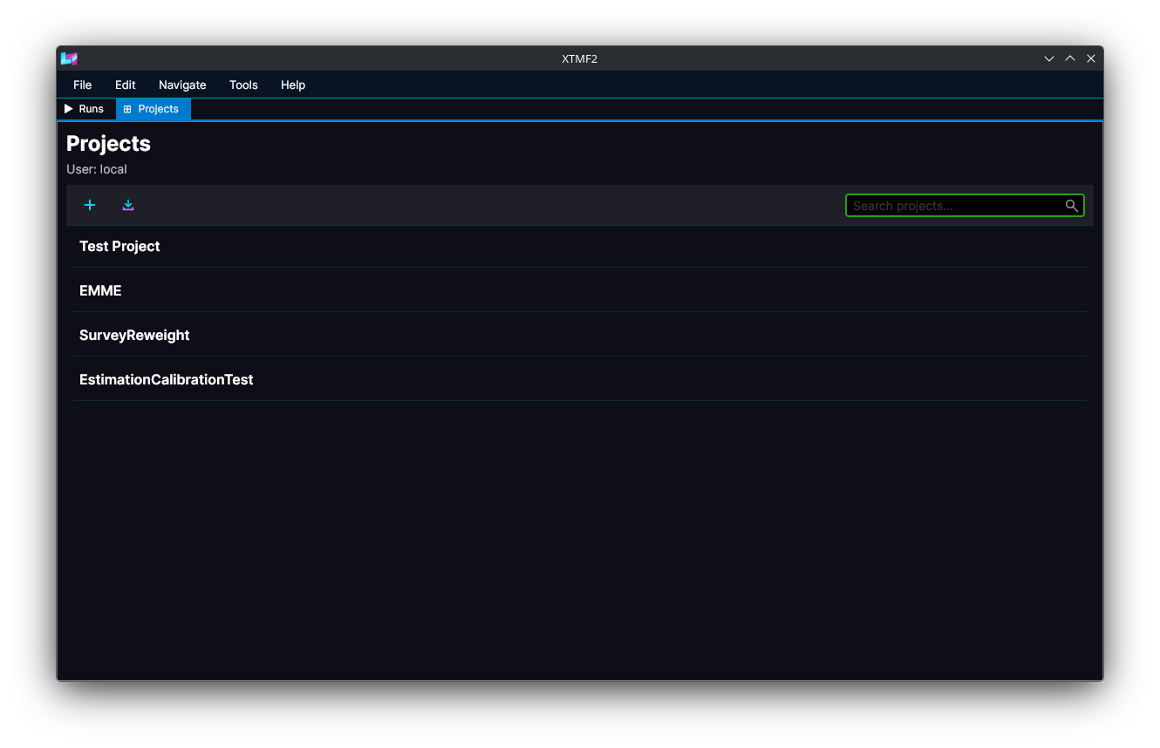
XTMF2 – Project Selection
Notes:
The initial window state for XTMF2, shows the local user’s projects. For the GUI right now, only the local user is supported, but future versions might allow for multiple users to interact with XTMF2 via a shared XTMF2 Server.

Slide 10
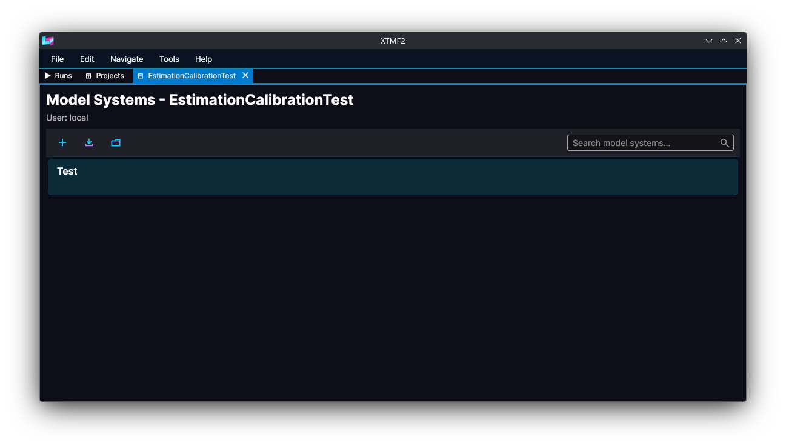
XTMF2 – Model System Selection
Notes:
This Window shows the model systems contained within James’ Estimation and Calibration Test project. In this case we have a single model system named Test.

Slide 11
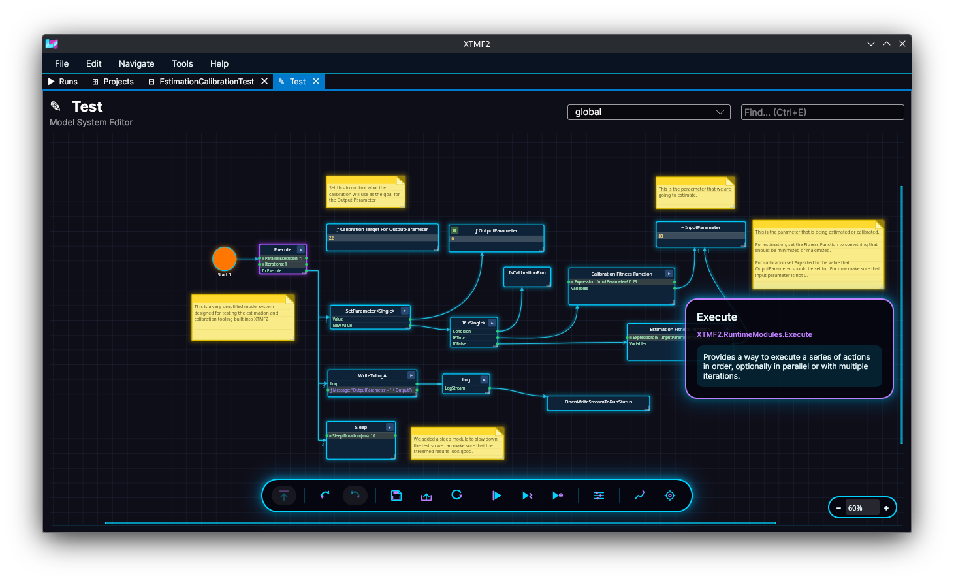
XTMF2 – Model System Editor
Notes:
This interface shows a zoomed out version of the Estimation and Calibration Test Model System.

Slide 12
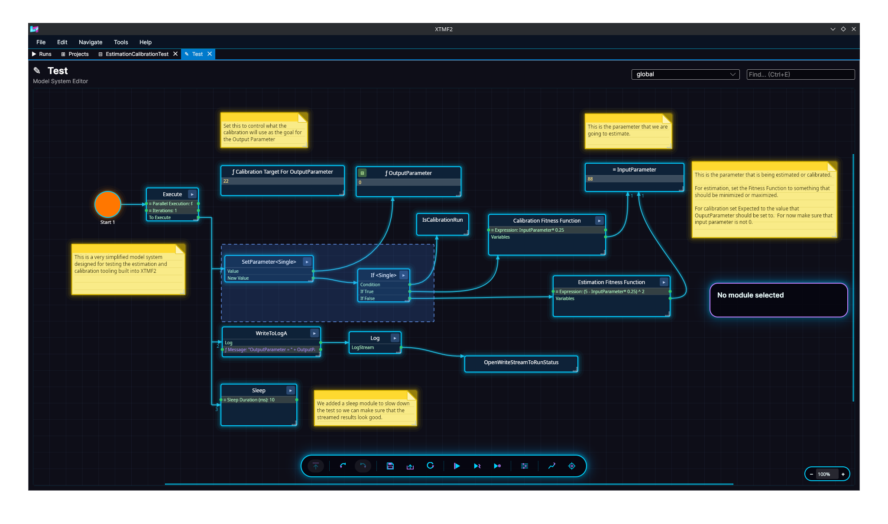
XTMF2 – Selecting Multiple Nodes
Notes:
You can select multiple items by holding down control and dragging with the left mouse button down.

Slide 13
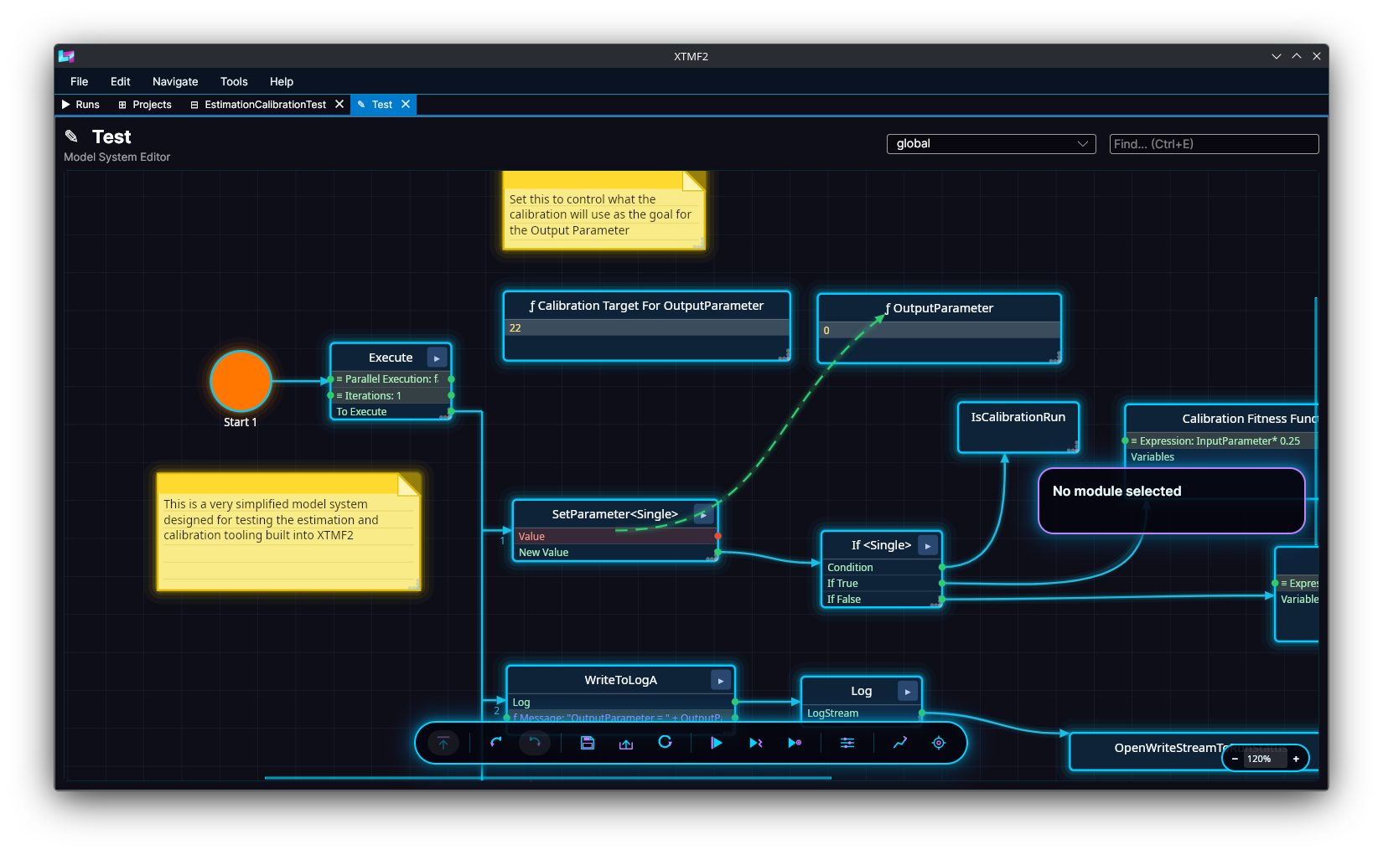
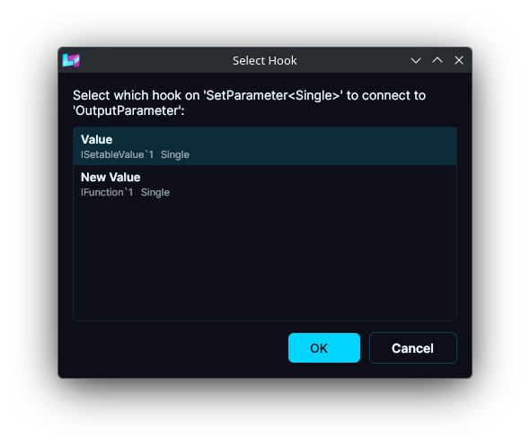
XTMF2 – Linking Nodes
Notes:
In this image we see the SetParameter<Single> module being linked to the OutputParameter. This is done by right clicking on the SetParameter<Single> and then dragging over to OutputParameter. Because there are multiple options for where we might want to pick to hook into SetParameter<Single> a dialog comes up for the user to select from.

Slide 14
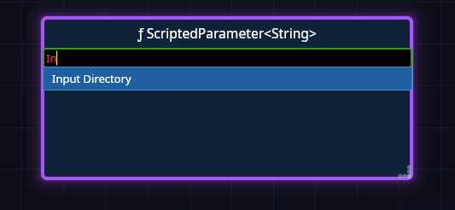
XTMF2 – Parameter Scripting
Notes:
Here we see a string value being assigned using XTMF2’s Parameter Scripting language. It supports working with strings, integers, floating point, and boolean values. Syntax is borrowed from C based languages.

Slide 15
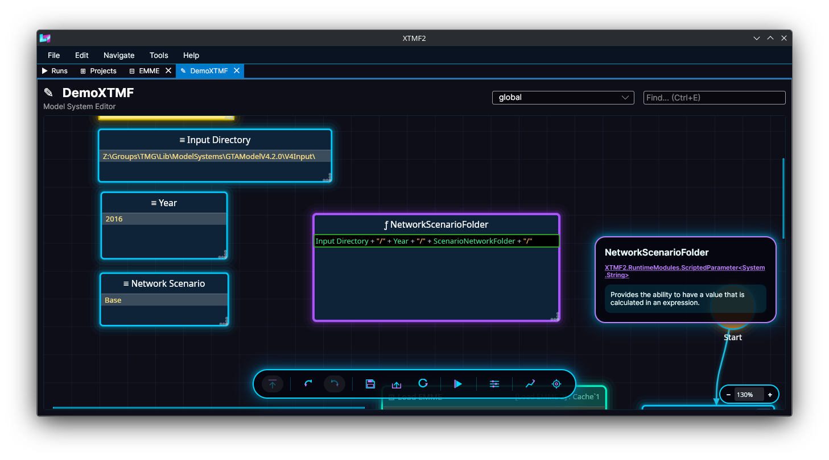
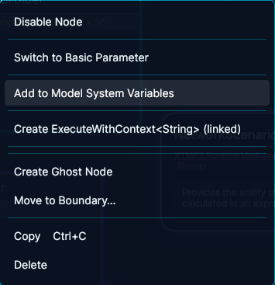
XTMF2 – Scripting Parameters

Slide 16
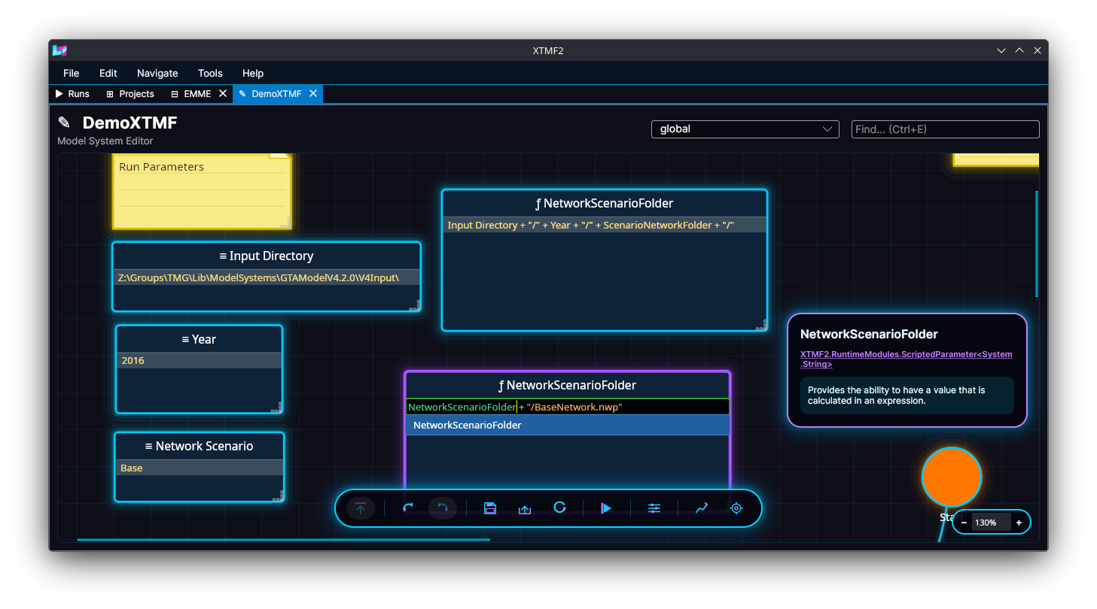
XTMF2 – Scripting Parameters
Notes:
Scripted Parameters can be used as inputs into other scripted parameters.

Slide 17
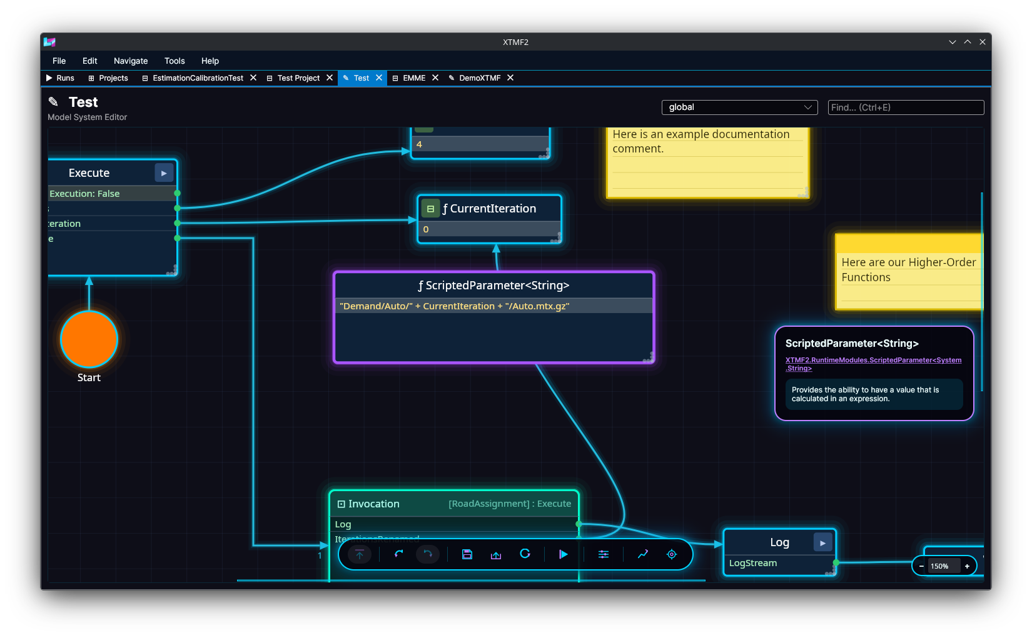
XTMF2 - Scripting Parameters
Notes:
Scripted parameters are evaluated at runtime, allowing us to do things like store the demand for a mode to different paths depending on the current iteration.

Slide 18
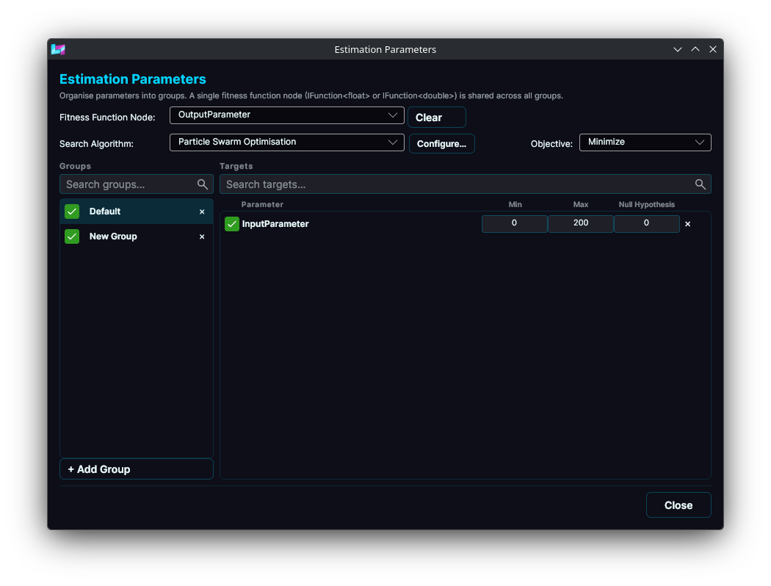
XTMF2 – Estimation Setup

Slide 19
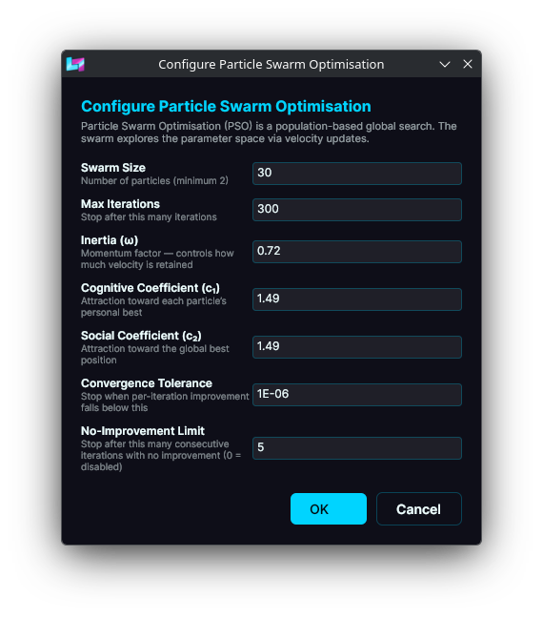
XTMF2 – Estimation Parameters

Slide 20
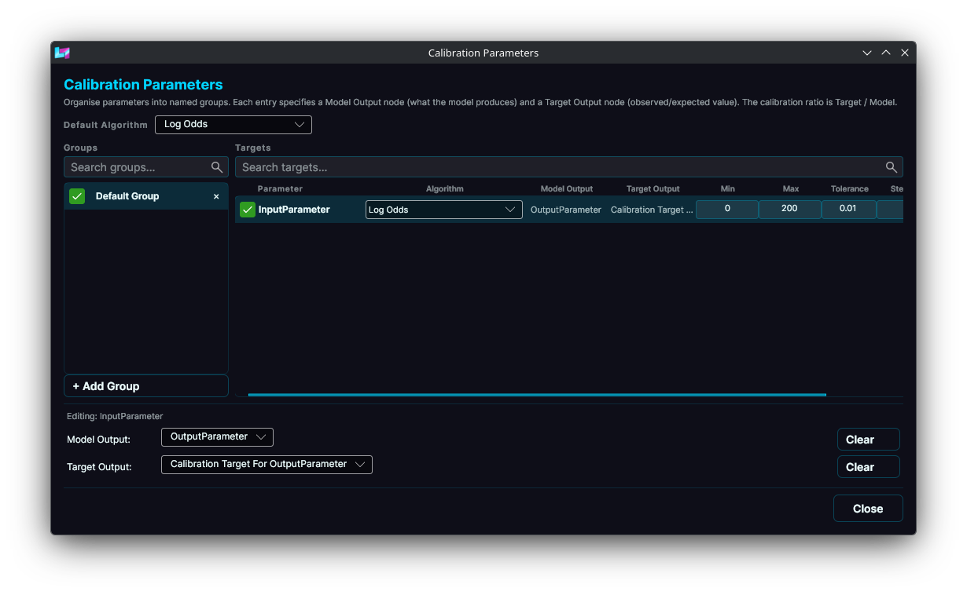
XTMF - Calibration

Slide 21
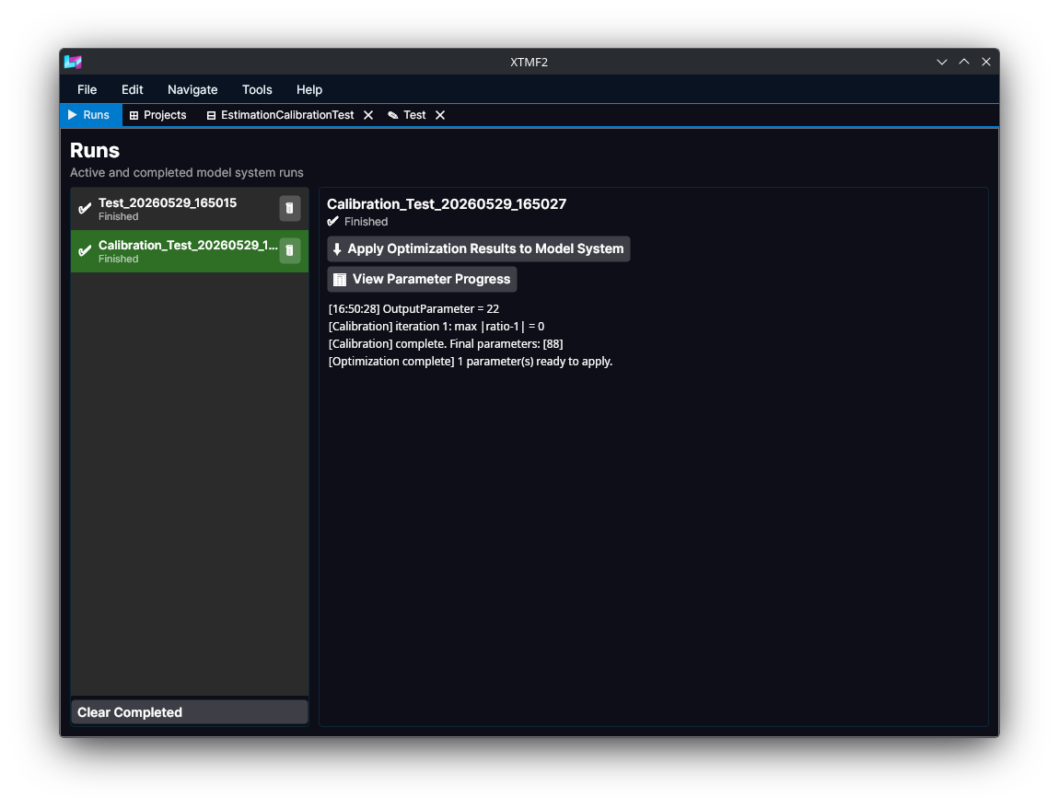
XTMF2 – Run Window
Notes:
The Runs tab gives us information for all of the runs that have been executed. This interface is “functional” at the moment and will have significant modifications before Release.

Slide 22
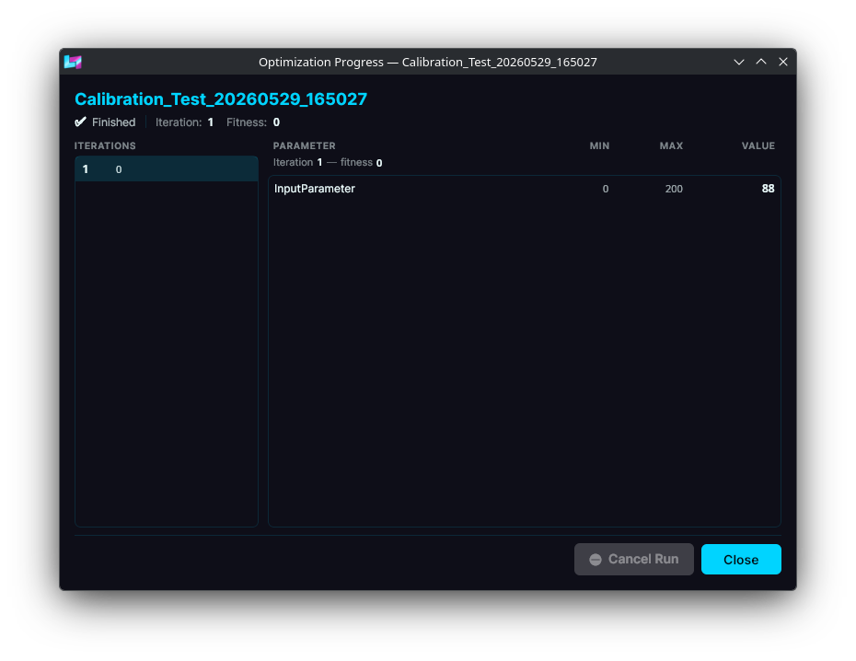
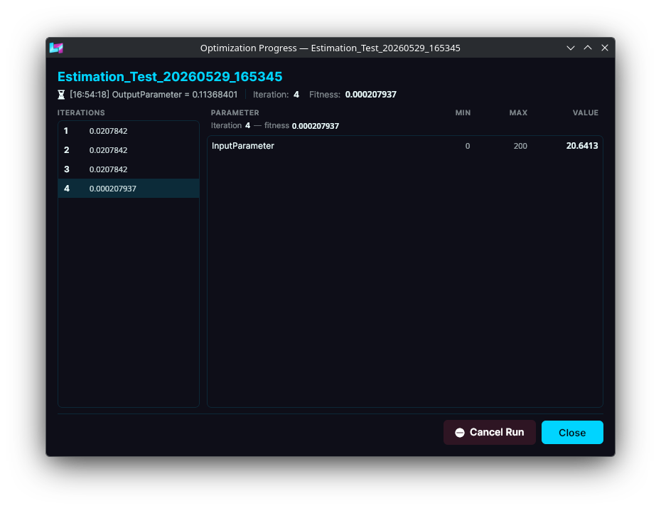
XTMF2 – Optimization Progress
Notes:
A GUI Interface for reading in the results live from an estimation or calibration run. These interfaces will likely change to provide better analysis of how parameters are being changed over time.

Slide 23
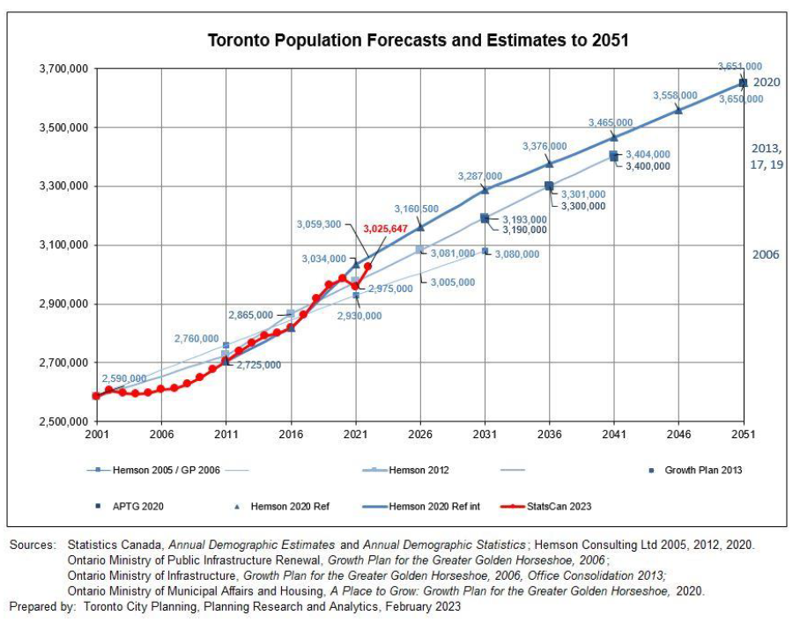
Review of GTHA Pop/Emp Forecasting Procedures

Slide 24
Population & Employment Inputs to a Travel Demand Model
A fundamental input to all travel demand models is a forecast of population and employment for every traffic analysis zone (TAZ) in the study area.
“Errors” in these forecasts will propagate throughout the demand forecast.
Arguably uncertainties in these pop/emp forecasts may be the greatest in the entire forecasting process.
The pop/emp forecasts are generally produced by people other than those running the travel demand model. I.e., they are generated exogenous to the demand forecast process itself.
In Ontario, since 2024 each municipality/agency is responsible for generating its own pop/emp forecasts.
Methods vary by municipality.

Slide 25
Generic Pop/Emp Forecasting Process
Generate total pop & emp by CSD/municipality
Allocate CSD pop & emp to TAZs
Synthesize individual person & household agents and job objects for each TAZ (e.g., MetroPop)

Slide 26
Pop/Emp Control Totals by Municipality: E.g., Hemson Procedure
Many municipalities employ Hemson Consulting to produce forecasts of population & employment control totals.

Slide 27
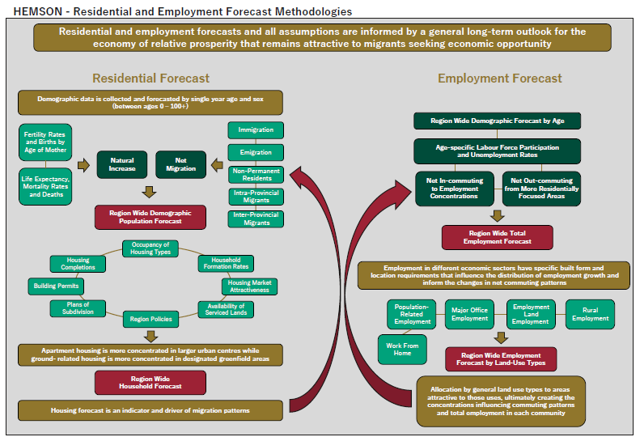
Hemson Forecast Procedure
(Source: Hemson Memo to Region of Peel, “Scenario 1 and 2 Peel Forecasts Key Assumptions and Method”, March 26, 2025)

Slide 28
Allocation of Pop/Emp to TAZs
Two examples:
  City of Toronto Planning Department.
  Land Use Allocation System (LUAS) – Metrolinx & MTO.

Slide 29
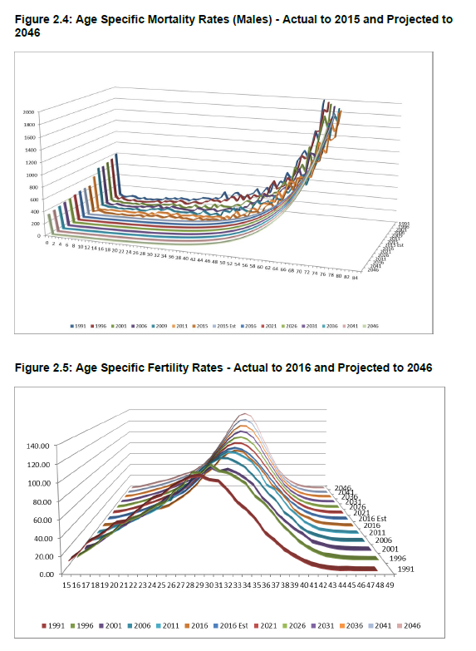
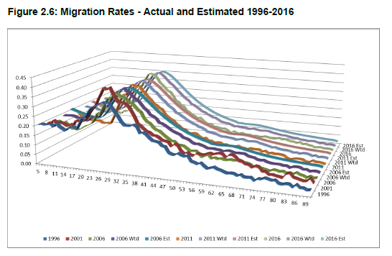
Population Forecasting
Cohort-survival model (births/deaths by year).
Assumptions re. immigration & out-migration.
Assumptions re. housing supply.
Generates population by age & sex
  Implicitly also immigration status.
Households also explicitly or implicitly generated.

Slide 30
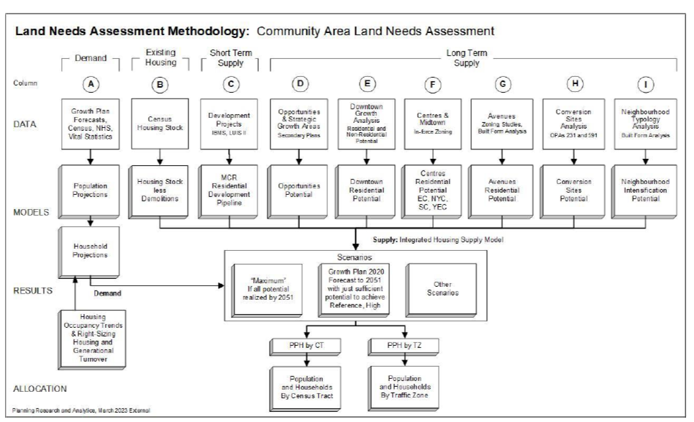
City of Toronto Population Forecasting Procedure
(Source: Staff report to Planning & Housing Committee, City Planning, City of Toronto, April 13, 2023)

Slide 31
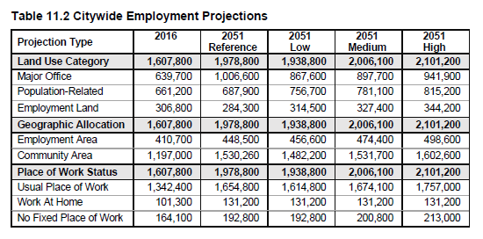
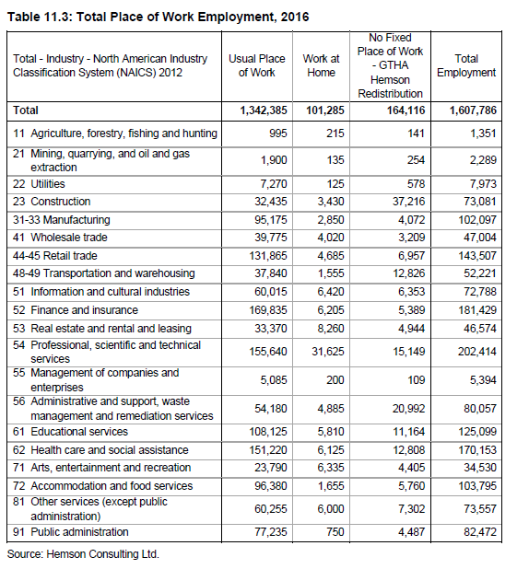
Employment Forecasting
Employment generally projected based on:
  Industry categories.
  Commercial floorspace assumptions.
  Labour force participation rate assumptions.
  City of Toronto: employment by PoW status.

Slide 32
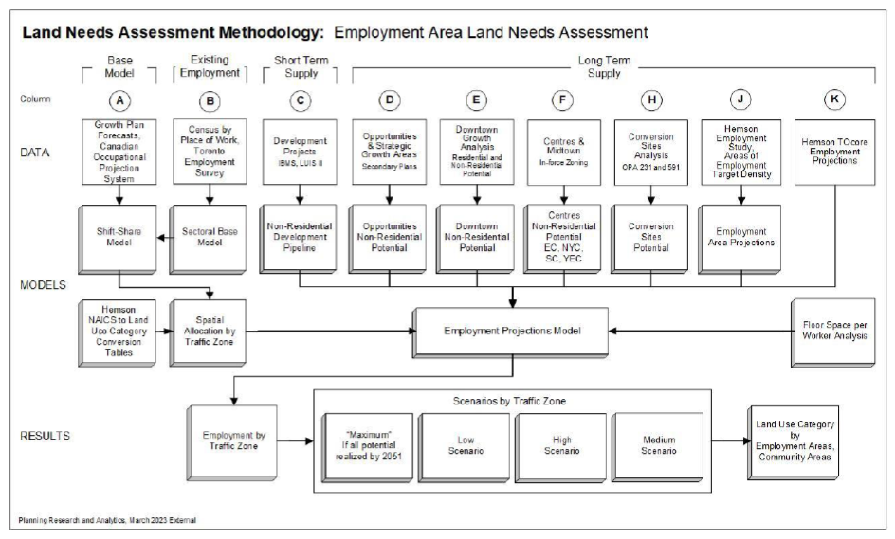
City of Toronto Employment Forecasting Procedure
(Source: Staff report to Planning & Housing Committee, City Planning, City of Toronto, April 13, 2023)

Slide 33
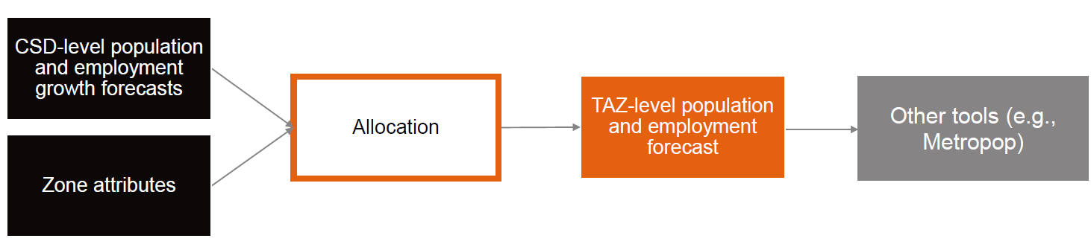
LUAS
Deterministic, static allocation system to distribute forecasted pop & emp growth at the CSD level to the TAZ level.
  Pivots off base year totals.
Population categories:
  Ground-related.
  Apartment.
Employment:
  Major office.
  Employment land.
  Rural.
  Population-related.
Source: Arcadis, “Introduction to the Land Use Allocation System (LUAS)”,Workshop #1, June 25, 2024.

Slide 34
Observations (a preliminary list)
Population is usually projected by age & sex (and maybe immigration status), but this categorization is lost during the disaggregation process.
  PopSyn then makes its own assumptions about pop & sex distributions.
  Immigration status not explicit in current models.
  Can generally be assumed to be inconsistent with the aggregate forecasts.
Employment is usually projected by industry and/or land use type.
  EmpSyn splits total jobs by occupation type & employment status (FT/PT) with no explicit consideration of industry or land use type.
Implicit/explicit coupling of pop forecasts with housing & emp forecasts with land use.
  Implications for using demand models for housing policy analysis?
Regions are using different methods/assumptions.
  Strength: LOTS of local knowledge going into the analysis.
  BUT: Consistency in overall forecasts?
  Implications for consistency within a regional model such as GTAModel?
Ease of generating alternative pop/emp scenarios?
  Procedures are very data & labour intensive.
  Lots of interconnected assumptions.
LUAS appears to be unique in that it is sensitive to transport network accessibility.
  But means pop/emp forecasts change with network changes.
  Maybe a good thing, but also has issues.

Slide 35

Other Business

Slide 36
2025-26 Meeting Schedule
No meetings in July & August. As the song says, “See you in September”.
TMG Technical Advisory Committee Meetings (10:00-12:00):
    November 4, 2026
    January 6, 2027
    February 3, 2027
TMG Workshops (10:00-12:00):
    September 9, 2026
    December 2, 2026
TMG Steering Committee Meetings (10:00-12:00):
    October 7, 2026
    March 2,2027
All meetings online on MS Teams.

Slide 37
We are adjourned! Thank you!
The End!

